Slide 1
Crime and Community Investment in Philadelphia
Team: Gritty Philly
Erdös Institute Fall Boot Camp 2020
Github

Slide 2
The Project Idea
People have tried to forecast crime in the past using metrics like unemployment, location, education level, average salary, ect
Instead of looking at what can best predict crime I wanted to look at what might prevent it.

Slide 3
My Approach
Wanted to quantify a level of community investment in each zip code
Grabbed over 15 open data sets from opendataphilly,
Created a mega ‘community programs’ dataset that was grouped by zipcode and time
Parks, playgrounds, farmers markets, murals, schools, ect….
Analyzed both geospatially and as a function of time
Used LASSO regression to identify important variables in crime prediction
Used prophet to see how COVID affected crime immediately after lockdown
Focused exclusively on community programs

Slide 4
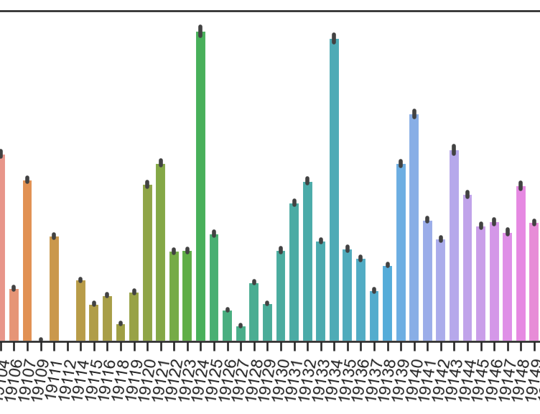



Methods and Packages Used

Slide 5
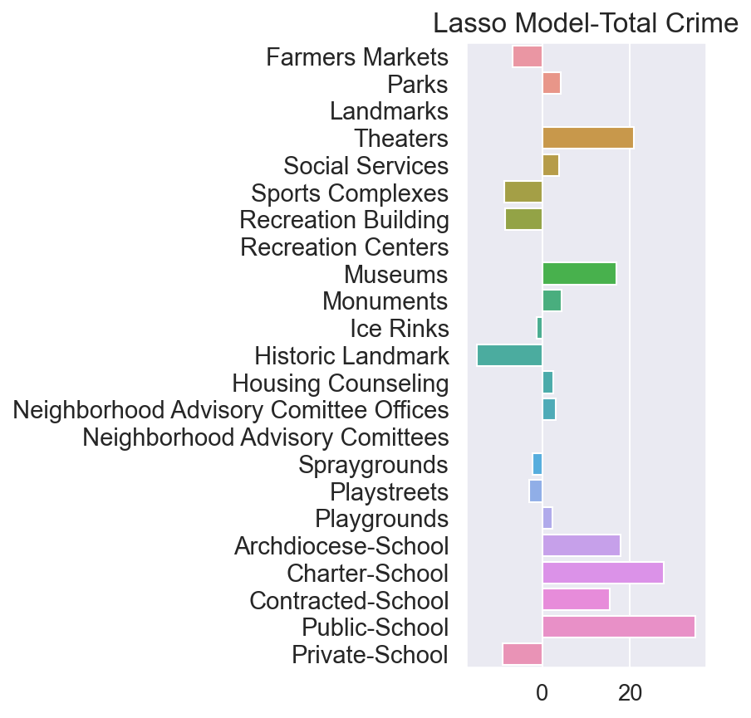
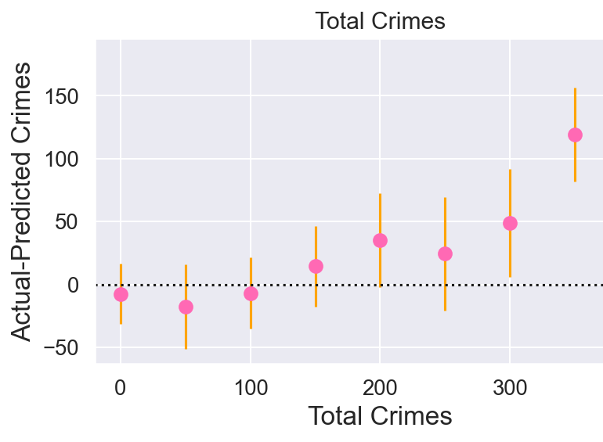
Results- LASSO (73% Acc)

Slide 6
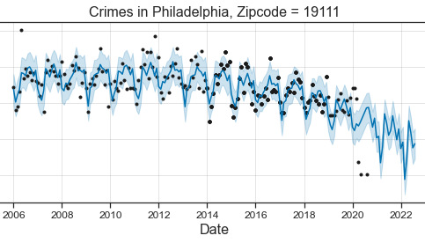
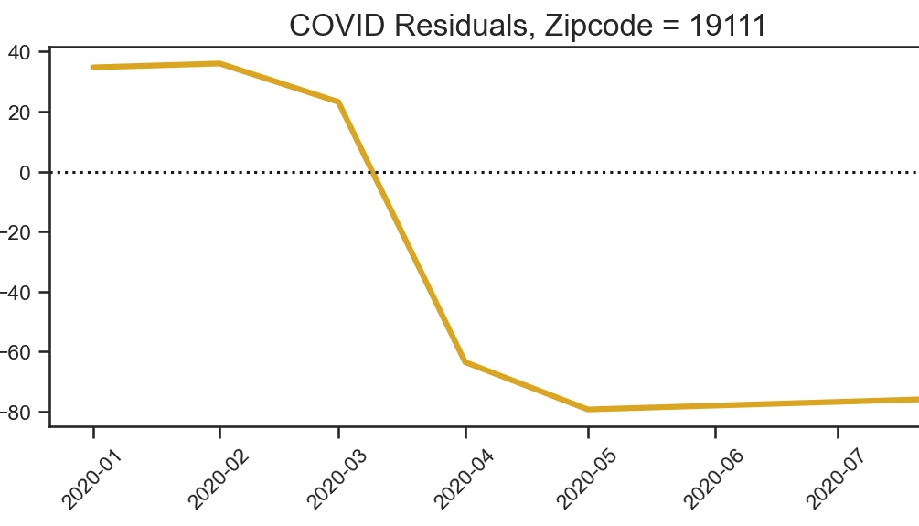
Results- prophet
Modeled each zip code individually
All showed some decline in crime in the early months of COVID
Notes:
Temple area

Slide 7

Next Steps
Move into neighborhoods instead of zip codes
Work more closely with those doing neighborhood work in Philadelphia
Get better data
Run analysis for each type of crime instead of simply crimes as a whole

